Slide 1

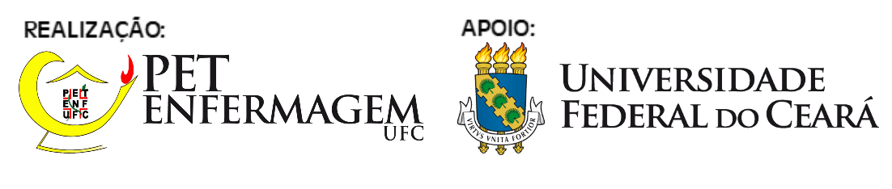
TÍTULO DA APRESENTAÇÃO
Autor¹
Coautor²
Coautor²
Coautor²
Coautor²
Orientador³

Slide 2
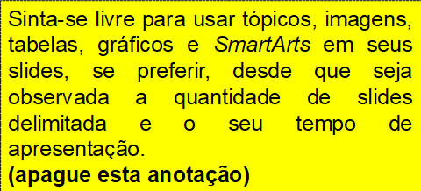
INTRODUÇÃO
Mercury is the closest planet to the Sun and the smallest one in the Solar System—it’s only a bit larger than the Moon. The planet’s name has nothing to do with the liquid metal, since it was named after the Roman messenger god, Mercury

Slide 3
OBJETIVO
You could enter a subtitle here if you need it

Slide 4
METODOLOGIA
Mercury is the closest planet to the Sun and the smallest one in the Solar System—it’s only a bit larger than the Moon. The planet’s name has nothing to do with the liquid metal, since it was named after the Roman messenger god, Mercury

Slide 5
RESULTADOS
Mercury is the closest planet to the Sun and the smallest one in the Solar System—it’s only a bit larger than the Moon. The planet’s name has nothing to do with the liquid metal, since it was named after the Roman messenger god, Mercury

Slide 6
RESULTADOS
Você pode utilizar essa segunda lâmina para os resultados. Caso não ache necessário, pode apagá-la.

Slide 7
CONCLUSÃO
Mercury is the closest planet to the Sun and the smallest one in the Solar System—it’s only a bit larger than the Moon. The planet’s name has nothing to do with the liquid metal, since it was named after the Roman messenger god, Mercury

Slide 8
REFERÊNCIAS
Mercury is the closest planet to the Sun and the smallest one in the Solar System—it’s only a bit larger than the Moon. The planet’s name has nothing to do with the liquid metal, since it was named after the Roman messenger god, Mercury

